Slide 1

Descending Into the details : Understanding Line search & Steepest
Descent Algorithm
Gaurav Phalkey Presented To
2211MC06 Dr. B. B. Upadhyay
M.Tech (M&C)

Slide 2
What is Gradient ?
In the case of a univariate function, it is simply the first derivative at a selected point. To check the line segment connecting two function’s points lays on or above its curve.
In the case of a multivariate function, it is a vector of derivatives in each main direction (along variable axes) called partial derivative. To check this function has to be twice differentiable and the Hessian is positive semidefinite
Gradient Descent doesn’t work for all Functions !!
A function has to be
Differentiable

Slide 3
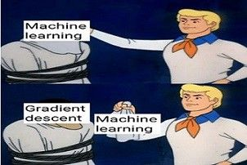
Motivation
Why Do we care so much about Gradient Descent ?
Most ML & Deep Learning techniques involve the minimization of a loss () and this method that serve the purpose

Slide 4
Gradient Descent , Finally !!
Gradient descent (also often called steepest descent) is a first-order iterative optimization algorithm for finding a local minimum of a differentiable function.
French Mathematician, Augustin-Louis Cauchy, first suggested it in 1847 .
The main goal is to converge to the minima of the loss functions in the least amount of time. This involves converging fast to the minima in a computationally efficient manner.
Gradient descent, although computationally efficient, provides a slow rate of convergence.
This is where line search strategy comes into picture which finds good value of step size & hence better rate of convergence at a slight increase in computational spending.

Slide 5

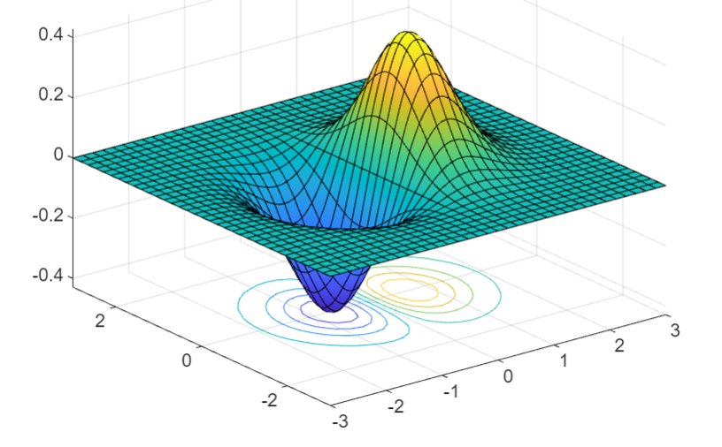
Unconstrained Minimization

Slide 6
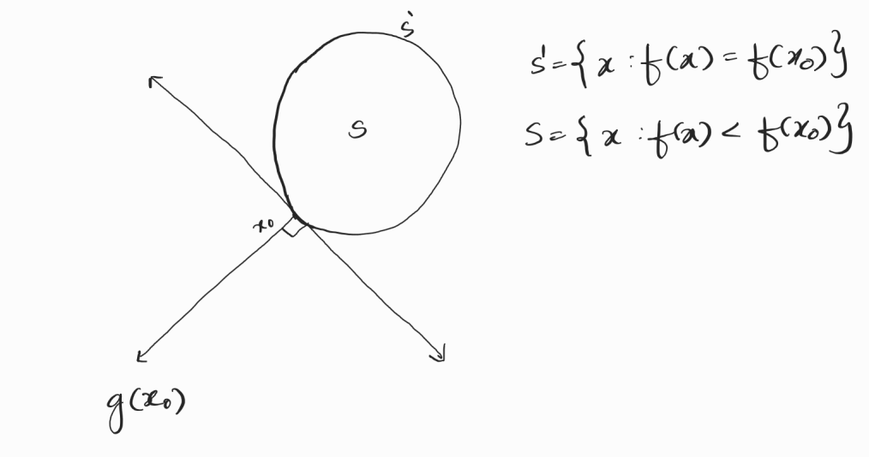


How to check whether direction is Descent direction or not?

Slide 7

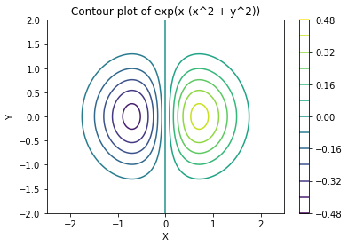
Value of function decreases if we move towards the inner most concentric circle
and increases if we move away from local minimum.
( So it is characteristics of local min point , that function value does not decrease in local neighbourhood of local min point, it either remains constant or increases ) .

Slide 8
One Interesting FACT is that Local Minimum is a point where does not exist a Descent direction
It is Nothing but a FONC for Unconstrained Minimization
It provide stopping condition for optimisation algorithm

Slide 9



g(x) = $\left({\exp\left(−x_{1}^{2}−x_{2}^{2}\right)(1−2x_{1}^{2}) \atop \exp\left(−x_{1}^{2}−x_{2}^{2}\right)(−{2x}_{1}x_{2})}\right)$
Need higher order derivative to tell which stationary point is local minima
Which take us to
“ SONC ”

Slide 10


SONC
Let $f$ : $R^{n}$→ $R$, $f$ ∈ $C^{2}$ , if $x^{∗}$ is local minimum of $f$ then g($x^{∗}$) =0 & H($x^{∗}$) is Positive Semi-definite
But wait !!
This Second order Necessary condition are not sufficient
we need something else……….
SOSC

Slide 11




Slide 12


But it has some problems too !!

Slide 13

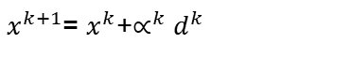
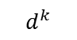
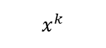
Step length determination
$$d^{k}$$
$x^{k+1}$= $x^{k}$+$∝^{k}$ $d^{k}$
$$x^{k}$$
Solving this Optimisation problem for above optimisation problem is computationally expensive
So we move towards Inexact line search method

Slide 14
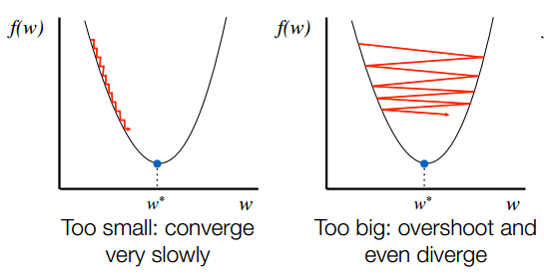
Inexact Line search Method
An inexact line search will find the largest α among a discrete set of values such that a sufficient decrease condition is achieved
Problems with Inexact line search method is that depends on sequence generated
Small Decrease in Functional Value relative to step length
2 .Step size are too small comparison to intial rate of decrease of function

Slide 15
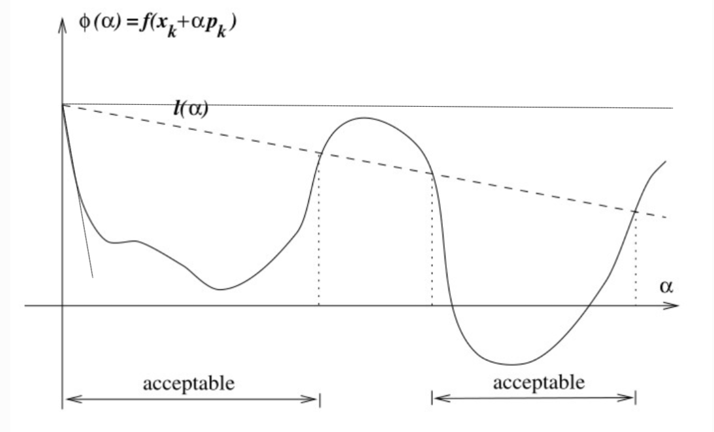
Armijo’s Condition
Armijo’s conditions ensures sufficient decrease in functional value
To ensure sufficient decrease in functional value , have to choose alpha value such that
Decrease in functional value at new alpha is
atleast some fraction times decrease in
functional value when alpha is 0.

Slide 16
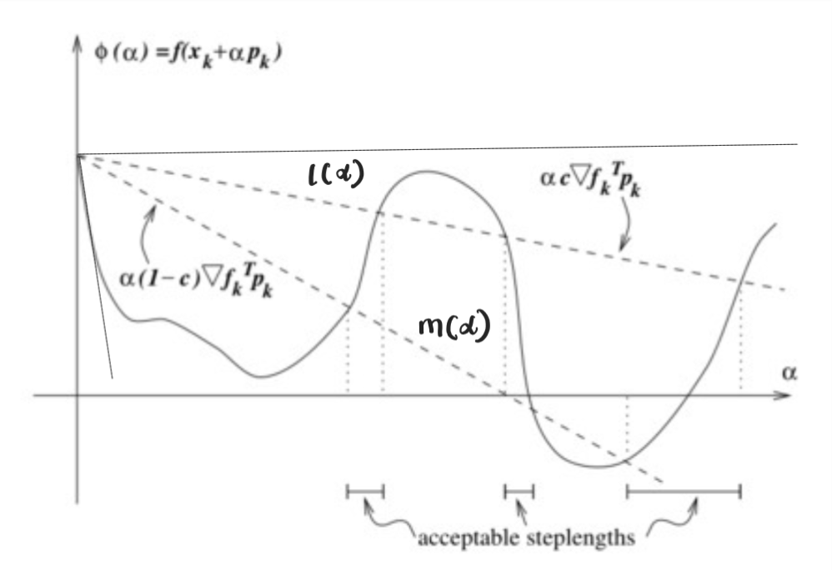

Goldstein’ s condition
Armijo’s Condition does not ensure that step length are sufficient large .
To ensure sufficient increase in step length value , have to choose alpha value such that
Decrease in functional value at new alpha is
atleast some fraction times decrease in
functional value when alpha is 0.

Slide 17
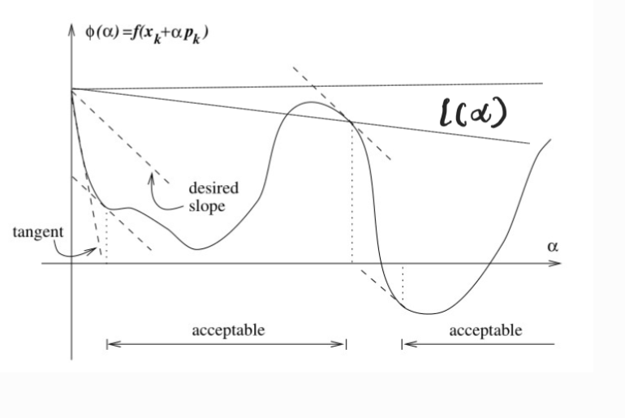
Wolfe’s Condition
Wolfe’s Suggested that desired slope is some prescribed times( greater than 1) slope when alpha is zero .
We are interested in those interval in which functional value has slope in desired range
So the conclusion we got here
Armijo’s condition + Goldstein’s Condition <<<<< Armijo’s Condition + Wolfe’s Condition

Slide 18

Finally , Our Steepest Descent algorithm Becomes

Slide 19

Global Convergence of Line Search Algorithm
By Line search algorithm, $∇$ f($x_{k})$Convergent if $\left\|∇\text{f}\text{(}x_{k})\right\|$ → 0
$\lim_{k\text{→}∞}\left\|∇\text{f}\text{(}x_{k})\right\|\text{ →}\text{ 0}$
By Zoutendijk’s theorem if line search satisfy Wolfe’s Condition then it has to satisfy the angle between search and steepest direction is bounded away by 90 degree
Let $∇$f is Lipschitz continuous , $α_{k}$ is step length $θ_{k}$ is the angle, then $\sum_{k=0}^{∞}{\cos^{2} θ_{k} {\left\|∇\text{f}\text{(}x_{k})\right\|}^{2}} < ∞$

Slide 20

The Zoutendijk’s conditions above implies that $\lim_{k→∞}{\cos^{2} θ_{k}}$ ${\left\|∇\text{f}\text{(}x_{k})\right\|}^{2}=0 ,$ Hence if angle search direction with gradient away by 90 degree then 0 <$\cos^{2} θ_{k}$
By $n^{th}$ divergence test 0< ε ≤ $\cos^{2} θ_{k}$ for all k
It follows that $\lim_{k\text{→}∞}\left\|∇\text{f}\text{(}x_{k})\right\| \text{=}\text{0}$

Slide 21

Why Gradient descent : Not the best Optimization technique but works best in Neural Network
On one hand , Gradient Descent is by itself not the most efficient technique, as we use Gradient descent in the beginning ,only later when derivative become small, we start using more sophisticated techniques
ON the other hand , however, Surprisingly , there is application of Optimization where situation is reverse.
Back-Propagation in Neural Network which is just a algorithmic implementation of Gradient descent works optimally best in comparison to complex optimization technique
How can we explain this paradox ??

Slide 22
The beauty of the solution lies in its simplicity, far simpler than one might imagine.
The problems of machine learning are only in the first crude approximation described as optimization problems.
In reality, the desired solution should not be too close to the actual minimum of the objective function which is generally Loss function
Desired value of the objective function is supposed to be proportional to the number of training samples and to the accuracy required.
Since in machine learning, we do not need to get too close to the actual minimum, we thus do not need to switch from fast gradient descent to any other technique – and this explains why gradient descent is best in business
Supremacy of Gradient Descent Still Prevails !!

Slide 23
Batch Gradient Descent
Batch gradient descent sums the error for each point in a training set, updating the model only after all training examples have been evaluated. This process referred to as a training epoch.
While this batching provides computation efficiency, it can still have a long processing time for large training datasets as it still needs to store all of the data into memory.
One of the main drawbacks of batch gradient descent is that it can converge to a local minimum instead of the global minimum. This is because the algorithm updates the model parameters based on the average of the gradients of all examples in the batch.

Slide 24
Mini Batch Gradient Descent
Mini-batch gradient descent combines concepts from both batch gradient descent and stochastic gradient descent.
It splits the training dataset into small batch sizes & performs updates on each batches.
This approach strikes a balance between the computational efficiency of batch gradient descent and the speed of stochastic gradient descent

Slide 25
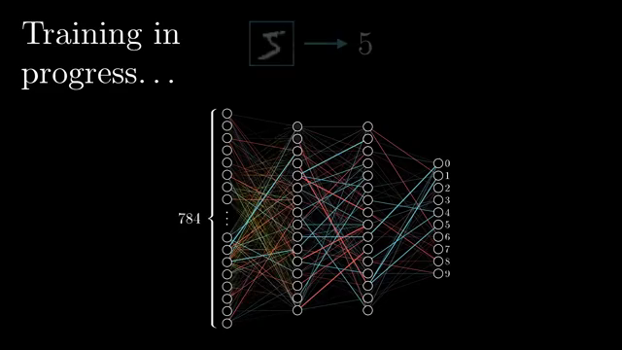
Stochastic gradient descent
It updates the model parameters based on the gradient of a single example at a time, rather than a batch of examples like in batch gradient descent.
Since only one training example is processed at a time, it is easier to store in memory
It is more computationally efficient.

Slide 26
References
Smith, A.M. (2018). Why Gradient Descent – Not the Best Optimization Technique – Works Best in Neural Networks: Qualitative Explanation. arXiv preprint arXiv:1803.04781
Dai Z, Wen F. Global convergence of a modified Hestenes-Stiefel nonlinear conjugate gradient method with Armijo line search. Numerical Algorithms. 2012 Jan;59(1):79-93
https://optimization.cbe.cornell.edu/index.php?title=Line_search_methods#cite_note-nocedal-1%20paper

Slide 27
Thank You all for being here !!
“ Steepest descent : Where every step is a step towards a better tomorrow , unless you step too far “

